Slide 1


HEALTHCARE
FRAUD DETECTION
Presented by Annie Choi, Truong Pham, Marcus Choi
Notes:
ANNIE

Slide 2



asdfsd
Introduction
Objectives
Exploratory Data Analysis
Feature Engineering
Scoring Metrics
Machine Learning Models
Feature Importance
Conclusions
Future Work
Questions
CONTENTS
Notes:
ANNIE

Slide 3





INTRODUCTION
What is healthcare fraud?
Submission of dishonest medical claims for the purpose of gaining profit.
Billing for services that were not provided
Performing unnecessary medical procedures for the purpose of gaining insurance gain
Misrepresenting the service provided
TYPES OF
HEALTHCARE
FRAUD
Duplicate submission of a claim for the same service
Charging for a more complex or expensive service than was actually provided
Notes:
TRUONG: Increase the type of health care fraud font to 12

Slide 4




IMPACTS OF HEALTHCARE FRAUD
Financial losses due to health care fraud are in the tens of billions of dollars each year
Increased expense resulting from fraud could mean the difference between making health insurance a reality or not
Alters the value and integrity of the healthcare system
Your logo
Notes:
TRUONG

Slide 5

OBJECTIVES OF THIS PROJECT
PREDICT fraudulent providers based on patient claims
MINIMIZE financial loss
IDENTIFY important factors related to fraudulent behavior
Notes:
TRUONG

Slide 6



PRE-PROCESSING OF DATASETS
Inpatient Claims
Claims
Potential Fraud Labels
Outpatient
Patient
Information
558,221 Total Claims
56 Total Features
Notes:
MARCUS:
4 seperate csv files from kaggle
Data mostly from 2009
Total of 558,221 total claims and 56 total features

Slide 7
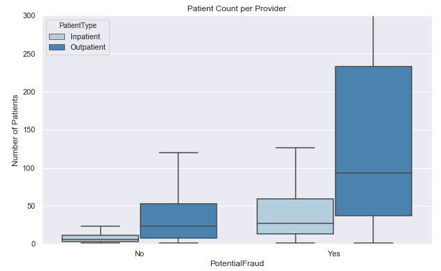
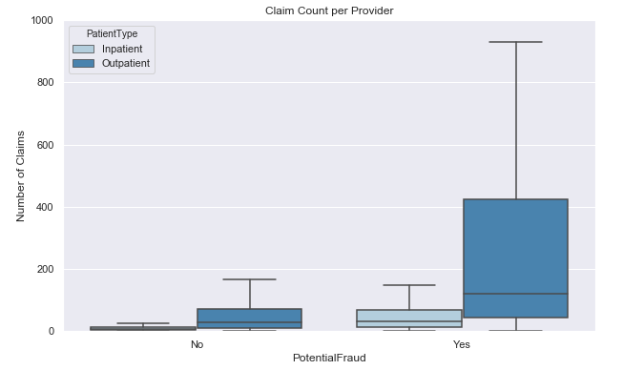
EDA: PATIENT AND CLAIM COUNTS
Notes:
MARCUS
First started EDA, by looking at relationships of explanatory variables and potential fraud
Ex: looked at unique patient counts and claim counts for flagged and unflagged providers.
Likelihood of potential fraud based on hospital size
Which providers are fraudulent and how can we tell?

Slide 8
EDA: DUPLICATE CLAIMS
DUPLICATED CLAIMS: Any claim submitted by a physician or provider for the same service provided to a particular individual on a specified date of service
Claims that have the same diagnosis, procedure, admit codes, and patient ID
DUPLICATED CLAIMS RESULT IN:
Delays and Loss in payment
Delays in fraud investigation
According to an OIG audit in 2017, Medicare paid New England providers twice for non-physician outpatient services that were provided before inpatient stays, resulting in an estimated $1 million in over-payments.
Notes:
ANNIE

Slide 9
EDA: DUPLICATE CLAIMS
0.17% of total Outpatient claims are duplicated
0.042% of total Inpatient claims are duplicated
10% of total providers with duplicated claims are Fraudulent
Feature Engineering: added ‘Duplicated Claim count’ and ‘Duplicate Claim Percentage’
Notes:
ANNIE

Slide 10
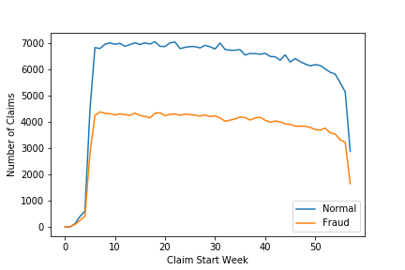
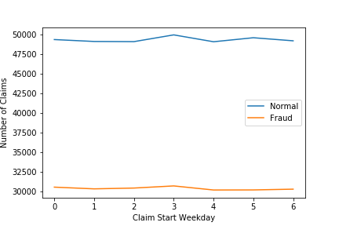
ANALYSIS FOR TIME-RELATED FEATURES
START WEEK AND WEEKDAY
The patterns for fraud providers are similar to normal providers
Notes:
TRUONG

Slide 11
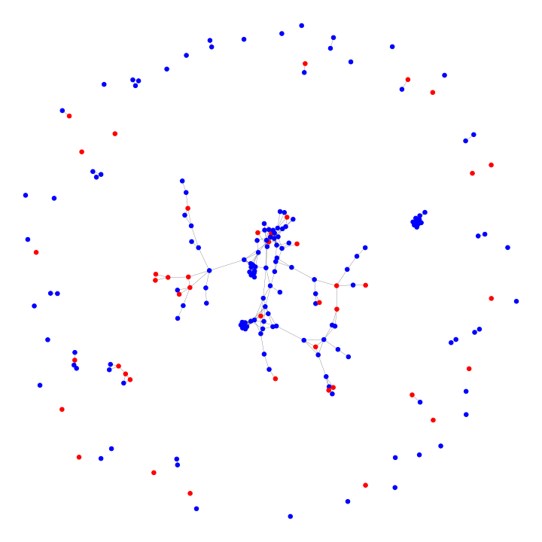
NETWORK ANALYSIS: DEFINITION
Network containing providers as nodes
Providers who share AttendingPhysician will have a connection
A sample network of providers
Fraud providers: In red
Notes:
TRUONG

Slide 12
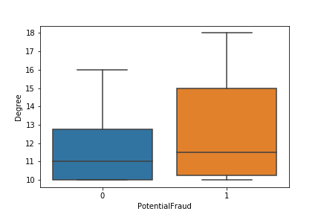
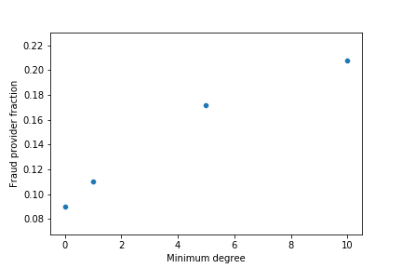
Network Analysis: Statistics
Fraud providers tend to be more connected
Introduce two new feature columns: “isConnectedtoFraud” and “NetworkDegree”
Notes:
TRUONG

Slide 13

FEATURE ENGINEERING
Original dataframe: each observation by patient claim
New dataframe: each observation by provider
Fraud labels by provider
New predictors
558,221 Total Claims
56 Total Features
5,410 Total Providers
65 Total Features
Notes:
MARCUS
Converting claims to providers df required all new features

Slide 14

MODEL
SCORING
METRIC
BUSINESS
SCORE
Traditional scores unable to capture the actual effect on business
Introduced a business score
Assumptions: save 1876.7 USD per true positive and it takes 8 hours at 20 USD/hour to investigate (penalize false positives)
Business_score = (1876.7*(TP-FN)-8*20*(FP+TP))/((1876.7-8*20)*(TP+FN))
Your logo
Notes:
MARCUS
Average claim cost per provider
Avg cost feature -> recall ignores false positive therefore not a perfect score
Accuracy score doesn’t take into account false negative therefore losing some money
F1 -> avg but doesnt take into account the business cost
Score + making money and - means losing money

Slide 15
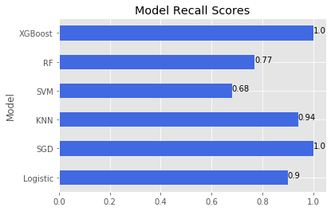
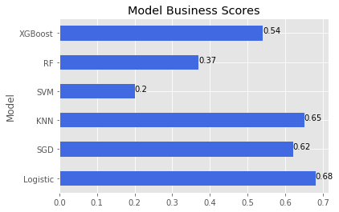
Model Performance
Notes:
ANNIE: For some non linear models, we get a high recall score, but low business score because of false positives that it will cost us money to investigate them

Slide 16
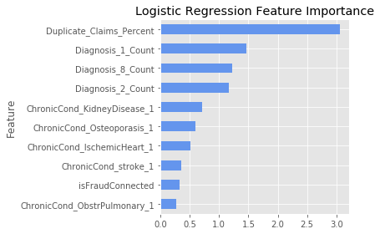
Feature Importance
Notes:
ANNIE: Duplicate Claims Percent, also mention that it is in the best interest for companies to filter out all duplicate claims (accidental or fraudulent), but for the purposes of finding fraudulent providers we used claim date

Slide 17

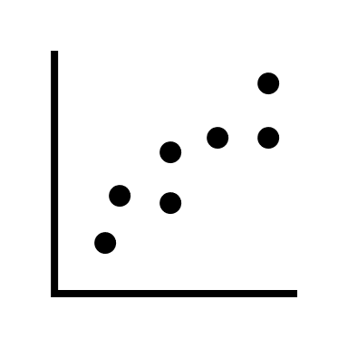

FUTURE WORK
Additional research of domain knowledge and deeper understanding of the datasets
Research and utilize unsupervised machine learning algorithms such as clustering and market basket analysis
Addition of new and recent data to predict better results
Notes:
MARCUS:

Slide 18
THANK YOU

